Slide 1

Amazon Web Services
workshop
for System Engineer
Using Amazon
Virtual Private Cloud (VPC)

Slide 2
Topics
Understand of Amazon Virtual Private Cloud (VPC)
Lab:
Create Amazon VPC
Configure EC2 instances to use Private/Public VPC
VPC Case Study: MongoDB Replica Set & Sharding

Slide 3
Objectives
You will be able to
Create VPC with Public subnet and Private subnet.
Create Security Groups for VPC.
Assign Amazon EC2 instances into VPC.

Slide 4
What is Amazon VPC?
Amazon Virtual Private Cloud (Amazon VPC) lets you provision a logically isolated section of the Amazon Web Services (AWS) Cloud where you can launch AWS resources in a virtual network that you define.
You have complete control over your virtual networking environment, including selection of your own IP address range, creation of subnets, and configuration of route tables and network gateways.
You can easily customize the network configuration for your Amazon Virtual Private Cloud. For example :-
You can create a public-facing subnet for your web servers that has access to the Internet.
Place your backend systems such as databases or application servers in a private-facing subnet with no Internet access.
You can leverage multiple layers of security, including security groups and network access control lists, to help control access to Amazon EC2 instances in each subnet.
Additionally, you can create a Hardware Virtual Private Network (VPN) connection between your corporate datacenter and your VPC and leverage the AWS cloud as an extension of your corporate datacenter.

Slide 5
Multiple Connectivity Options
Connect directly to the Internet (public subnets).
Connect to the Internet using Network Address Translation (private subnets).
Connect securely to your corporate datacenter.
Connect privately to other VPCs.
Combine connectivity methods to match the needs of your application.

Slide 6
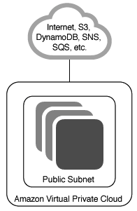
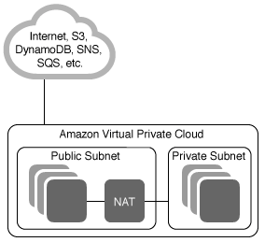
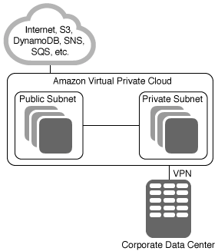
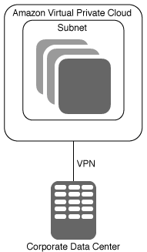
Amazon VPC Configurations
VPC with a Single Public Subnet
VPC with Public and Private Subnets
VPC with Public and Private Subnets
and Hardware VPN Access
VPC with a Private Subnet Only and Hardware VPN Access

Slide 7
VPC Use Cases
Host a simple, public-facing website.
Host multi-tier web applications.
Host scalable web applications in the AWS cloud that are connected to your datacenter.
Extend your corporate network into the cloud.
Disaster Recovery.

Slide 8
Use Case: MongoDB Replica Set and Sharding
MongoDB is an open-source NoSQL database, store data in JSON-style document.
MongoDB supports high-availability features such as Replication Set and Sharding.
With Amazon Web Services Architecture, you can designs your MongoDB clusters to serves a very large size from GB to TB of data a day.
Replication Set is a group of MongoDB processes that maintain the same data set. Replica sets provide redundancy and high availability, and are the basis for all production deployments.
Sharding is the process of storing data records across multiple machines and is MongoDB’s approach to meeting the demands of data growth. Sharding solves the problem with horizontal scaling. With sharding, you add more machines to support data growth and the demands of read and write operations.

Slide 9






MongoDB Replica Set & Shard
A
B
C
D
E
F
G
Load Balancer
Config Server 1
Routing Server A
Routing Server B
Config Server 3
Config Server 2
Shard A
Shard B
Replica A Primary
Replica B Primary
Replica A Secondary
Replica A Arbiter
Replica B Secondary
Replica B Arbiter
A
C
E
G
B
D
F

Slide 10
MongoDB and VPC
Public VPC
80, 443
Application Server
Application Server
NAT
443
Private VPC
27017, 27018, 27019
Config Server 1
Routing Server A
Routing Server B
Config Server 3
Config Server 2
Replica A Primary
Replica B Primary
Replica A Secondary
Replica A Arbiter
Replica B Secondary
Replica B Arbiter

Slide 11
MongoDB and Availability Zones
Availability Zone A
Availability Zone B
Config Server 1
Routing Server A
Routing Server B
Config Server 3
Config Server 2
Replica A Primary
Replica B Primary
Replica A Secondary
Replica A Arbiter
Replica B Secondary
Replica B Arbiter

Slide 12
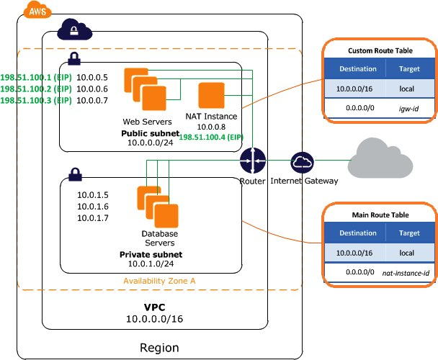
Lab Architecture

Slide 13
Lab: Building Your Public/Private Amazon VPC
Overview
In this lab. you create a basic virtual private cloud (VPC) and then extend it to produce a customized result. You do all of this with the AWS Management Console.
4 labs.
Topic Covered
Create a based Amazon Virtual Private Cloud (VPC).
Create public subnet.
Create private subnet.
Create Security Groups for EC2 instances in public and private subnet.
Note:
Do not delete ECS instance and VPC after complete this lab. Its will be used in the next chapter.

Slide 14
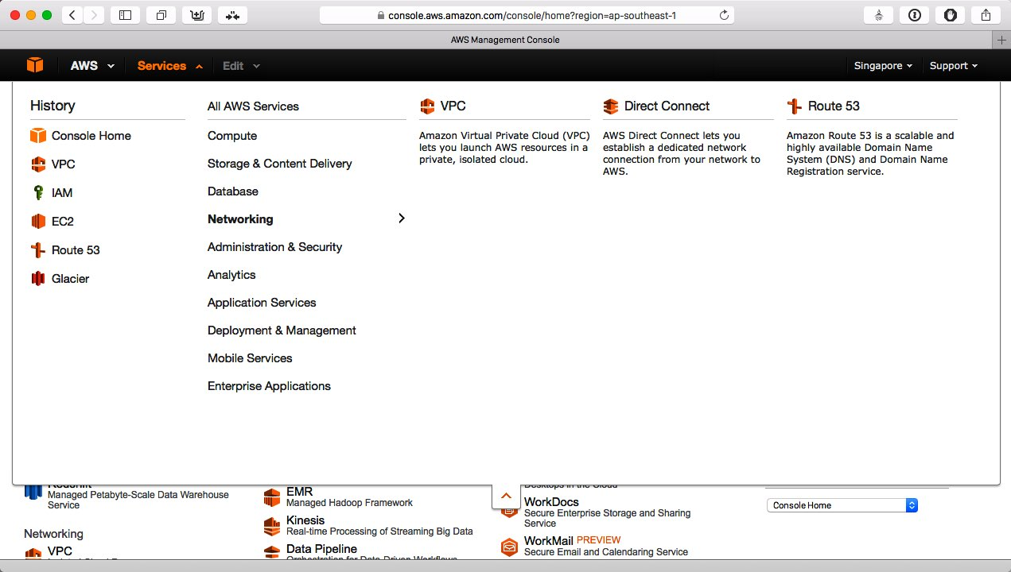
Lab 1-4: Login to AWS Console
Goto https://console.aws.amazon.com, enter AWS username and password and then click Login button.
In AWS Console, change Region to Singapore.
Click Services menu and choose VPC link under Networking group to open VPC console.
1
3
2

Slide 15
Lab 1-4: Launch VPC Wizard
On the VPC Dashboard, click Start VPC Wizard button.
Step 1. Choose VPC with Public and Private Subnets, click Select button. The VPC with Public and Private Subnets page contains several parameters. Depending on your professional background, and notation may appear unfamiliar. This is commonly know as CIDR block notation, so, for example, 10.0.1.0/24 can also be expresses as 10.0.1.0 with subnet mask of 255.255.255.0. The VPC itself is a Class B network in the 10.0.1.0 space. If you are familiar with the IPv4 address space, this will be familiar as one of the non-routable address blocks. The overall address space uses as IP CIDR block of 10.0.0.0/16, which is the equivalent of a subnet mask 255.255.0.0 (a full Class B network). You are going to keep most of the default values, with 2 exceptions.
In the VPC name, enter <your_name> VPC. (Example:- Jim VPC)
Under the Public subnet value, in the Availability Zone drop-down list, select an Availability zone. (Example:- ap-southeast-1a).
In the Public subnet name, enter <your_name> Public subnet.

Slide 16
Lab 1-4: Launch VPC Wizard
Under the Private subnet value, in the Availability Zone drop-down list, select the same Availability zone as in the previous step.
In the Private subnet name, enter <your_name> Private subnet.
In the Key pair name drop-down list, select your SSH key pair that was created in the first lab. You can leave this option as default if you don’t prefers to remote to the EC2 NAT instance.
Click Create VPC button, a dialog indicates the progress of creating your VPC. Click OK button. Your VPC has an important feature: everything is in a single Availability zone. In order to optimise application availability you have to distribute assets across zones, which means that you have to add another pair of subnets. Note that there is already a running instance, which is the NAT server that wizard created. The NAT server is an appliance in the sense that its only purpose is to allow servers in the private subnet to communicate with the internet in order to get updates, software packages, and so forth. It doesn’t allow internet clients to make connections to servers in the private subnet. Also note that it is assigned an Elastic IP, or NAT (Network Address Translation), address in order to facilitate internet communication from remote client.

Slide 17
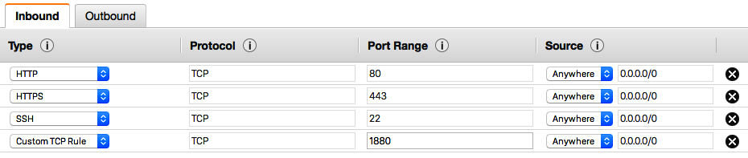
Lab 2-4: Create Security Groups for Public Access
Open Security group by select EC2 link in Services menu, click Security Groups under Network & Security in the left pane menu. You can see 2 default security groups here. One is created for you by default, and another one is created by VPC wizard for your EC2 NAT instance.
Click the security group for NAT, open tab Tags, add 2 tags…
Enter Group for Key and training for Value.
Enter Name for Key and NAT-SG for Value.
Click Create Security Group button.
Enter Public-SG for Security group name and Description.
In VPC drop-down list, select <your_name> VPC.
Add Inbound rules for HTTP, HTTPS, and SSH. Choose Source as Anywhere.
Add another Inbound rule for Custom TCP Rule, assign Port Range as 1880, and choose Anywhere for Source.

Slide 18
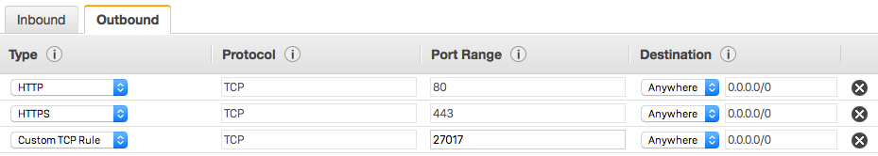
Lab 2-4: Create Security Groups for Public Access
Add Outbound rules for HTTP, HTTPS. Choose Source as Anywhere.
Add another Outbound rule for Custom TCP Rule, assign Port Range as 27017, and choose Anywhere for Source.
Click Create button.
Click the security group Public-SG, open tab Tags, add 2 tags…
Enter Group for Key, and training for Value.
Enter Name for Key, and Public-SG for Value.

Slide 19
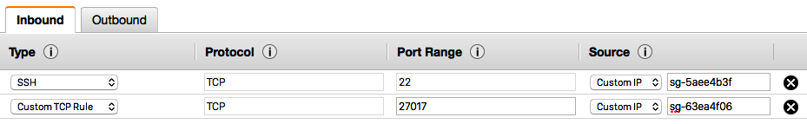
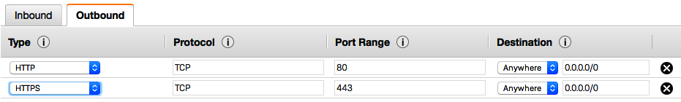
Lab 2-4: Create Security Groups for Private Access
Click Create Security Group button.
Enter Private-SG for Security group name and Description.
In VPC drop-down list, select <your_name> VPC.
Add Inbound rules for SSH, choose Custom IP for Source, type NAT Security Group-ID that created from lab 1-4.
Add Inbound rules for Custom TCP Rule, assign Port Range as 27017, choose Custom IP for Source, type Public Security Group-ID that created from previous steps.
Add Outbound rules for HTTP, HTTPS. Choose Source as Anywhere.

Slide 20
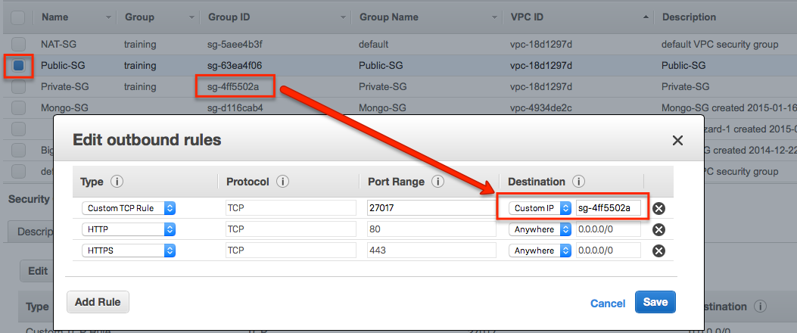
Lab 3-4: Update Security Groups for Public Access
Click Create button.
Click the security group Private-SG, open tab Tags, add 2 tags…
Enter Group for Key, and training for Value.
Enter Name for Key, and Private-SG for Value.
Select the Public-SG, click Outbound tab, click Edit button.
Change Destination for Custom TCP Rule from Anywhere to Custom IP, enter Private Security Group-ID.
Click Save button.

Slide 21
Lab 4-4: Create EC2 to uses VPC

Slide 22
References
Amazon VPC http://aws.amazon.com/vpc/
MongoDB
MongoDB Replication Set http://docs.mongodb.org/manual/replication/
MongoDB Sharding http://docs.mongodb.org/manual/sharding/

